Slide 1
Band-Aids on a Gunshot Wound
Judges 1:1–3:6
Dr. Andrew Spurgeon, Crossroads International Church Singapore
BibleStudyDownloads.org

Slide 2
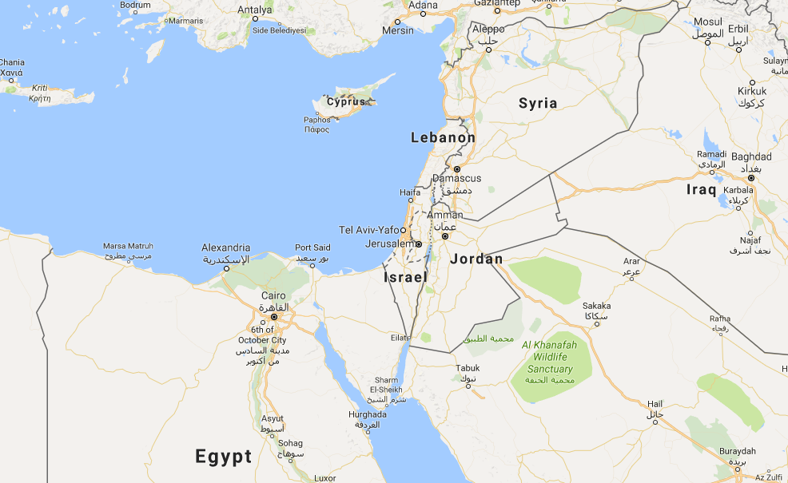

Slide 3
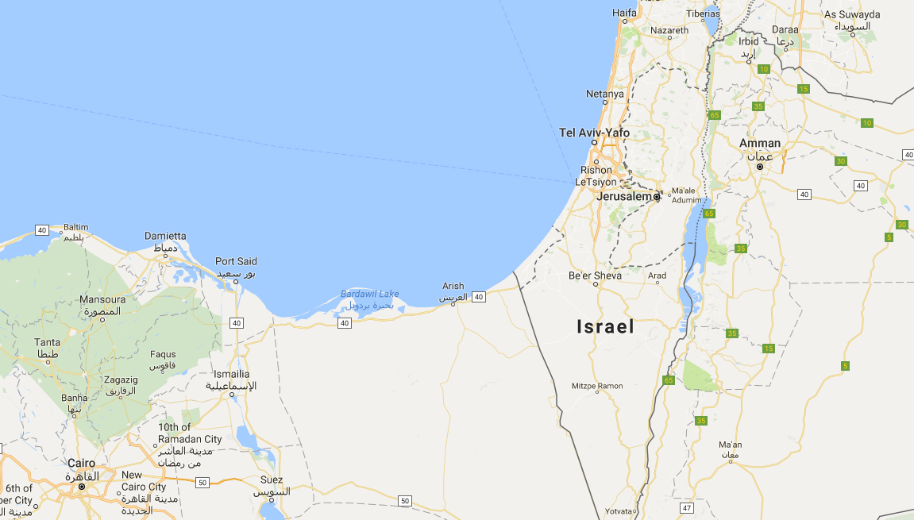

Slide 4
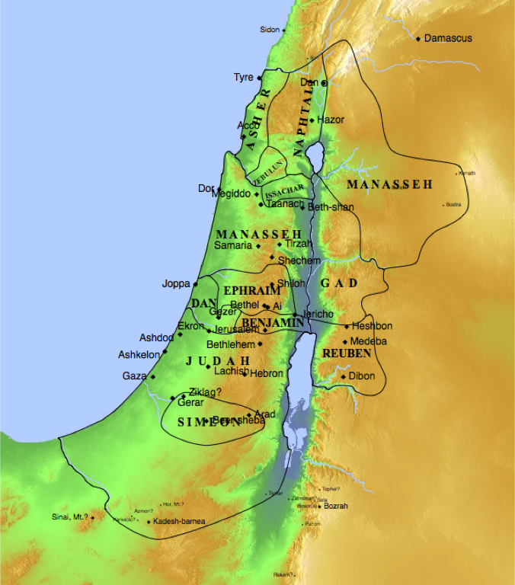

Slide 5
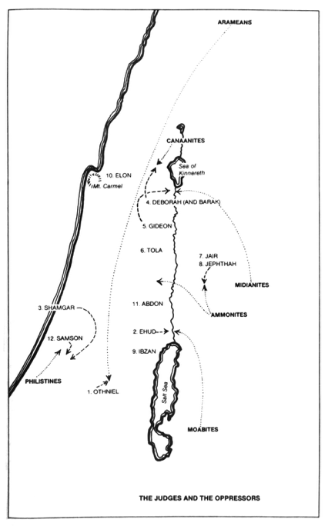

Slide 6
Years the Judges Ruled
174

Slide 7
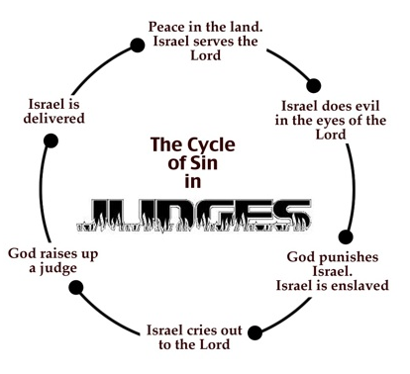

Slide 8
Judges
Why the title? The theme is: "In those days there was no king in Israel; each person did what was right in his/her own eyes" (21:25). In reality, God was their king (8:23), but they just didn't acknowledge Him as their king or live accordingly (see 7:18–20 and 9:7–15).
When they were in trouble and cried to God, however, God gave them "judges" or warriors to deliver them. They were temporary relief to a big problem (not submitting to God as their king). So, Rick and I see God's provision of these judges as "Band-Aids on a Gunshot Wound."

Slide 9
Years the Judges Ruled
174

Slide 10
1 cor 10:6 "Now these things occurred as examples to keep us from setting our hearts on evil things as they did."
Today's Lesson

Slide 11
Judges 1:1 Judges 2:1–9 Judges 1:2–36 Judges 2:10—3:6
Today's Lesson

Slide 12
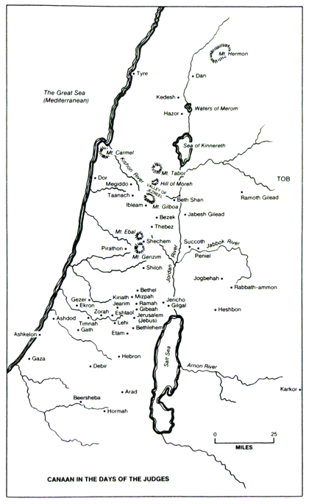

Slide 13
A Recollection of the History to remind them of their call and their failure (2:1–10)
Today's Lesson

Slide 15
Judah Led but Other tribes Failed to follow. The result: Cohabitation (1:2–36)
Today's Lesson

Slide 16
So God raised up Judges/warrior in Israel (2:10—3:6)
Today's Lesson

Slide 17
Black

Slide 18
OT Sermons link at biblestudydownloads.org
Get this presentation and script for free!

